Slide 1
Regularized and Stable Lexical Classification
in High-Dimensional Semantic Feature Spaces
Michela Deodati & Leonardo Pratelli
Based on Testa (2026) · Binder et al. (2016)
Supervisor: Prof.ssa Francesca Chiaromonte
Statistical Learning & Large Data II — Sant'Anna Pisa, A.Y. 2025–2026

Slide 2
MOTIVATION & DATA
Research Question & Dataset
Can we predict the grammatical word class from primitive semantic features?
Does high-dimensional expansion further improve classification?
535
65
434 / 62 / 39
428 / 107
Lexical entries
(nouns, verbs, adjectives)
Semantic feature
dimensions
Thing / Action / Property
(81% / 12% / 7%)
Train / Test
(stratified 80/20)
⚠ Class imbalance: a dummy majority classifier (always predict noun) achieves 81.3% accuracy — macro-F1 only 0.299. Balanced accuracy and macro-F1 are therefore the primary evaluation metrics.
2 / 15

Slide 3
PIPELINE
Analysis Pipeline
I
II
III
III+
IV
Data
Preprocessing
Unsupervised
Analysis
Supervised
Classification
High-Dim.
Extension
Cluster-label
Analysis
Cleaning · Split
Imputation · Scaling
PCA · K-Means
AHC · Diagnostics
Baseline · LASSO
Elastic Net · Post-sel.
2210 features
Screening (SIS)
K-Means labels
vs original classes
Extra: Alternative classifiers (SVM · Random Forest · k-NN) — same selected feature space
3 / 15

Slide 4
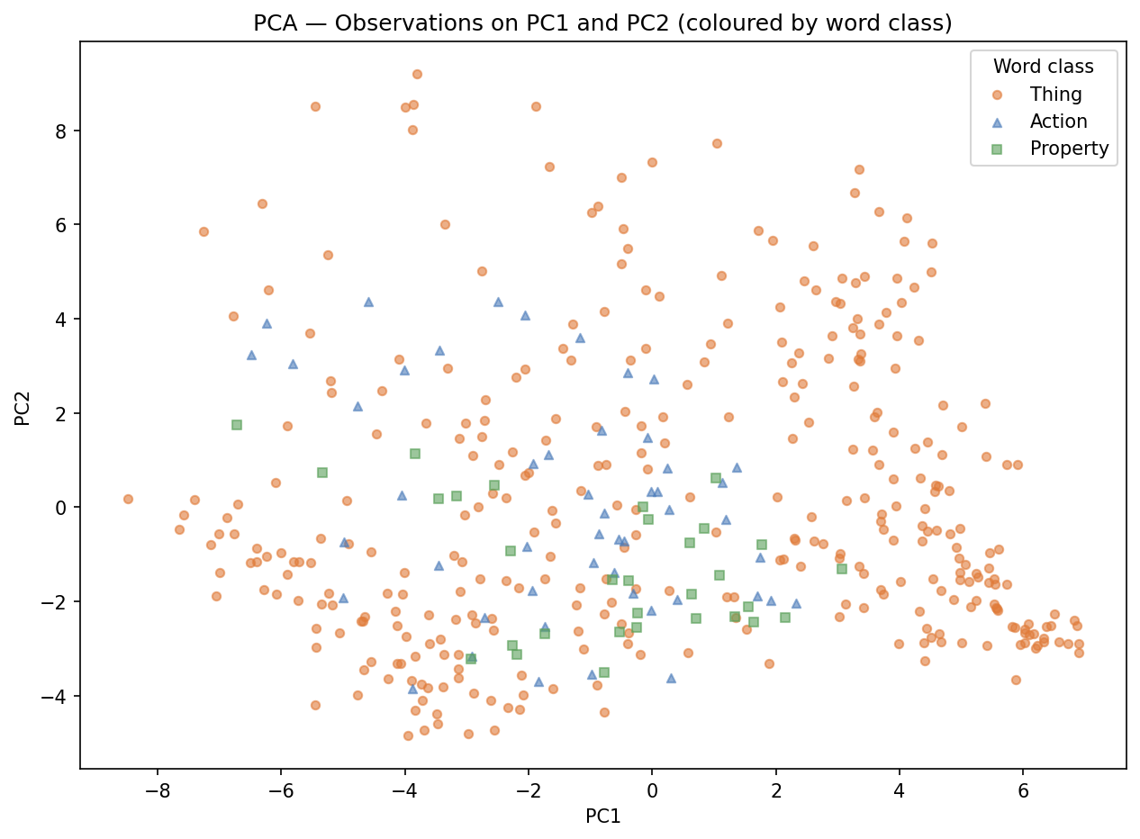
PHASE II — UNSUPERVISED
PCA: Variance Structure
▸ PC1 explains 22.7%, PC2 explains 13.4% — combined 36.1%
▸ 10 PCs needed to reach ~75% cumulative variance
▸ PC1: sensorimotor gradient (VISION, COLOUR, SHAPE, TOUCH, TEXTURE) — concreteness axis
▸ PC2: auditory/affective (FAST, SOUND, PAIN, ATTENTION, LOUD) — dynamic/eventive axis
▸ Broad but imperfect class separation — boundaries not sharp
PCA Biplot — PC1 vs PC2 (coloured by word class)
4 / 15

Slide 5
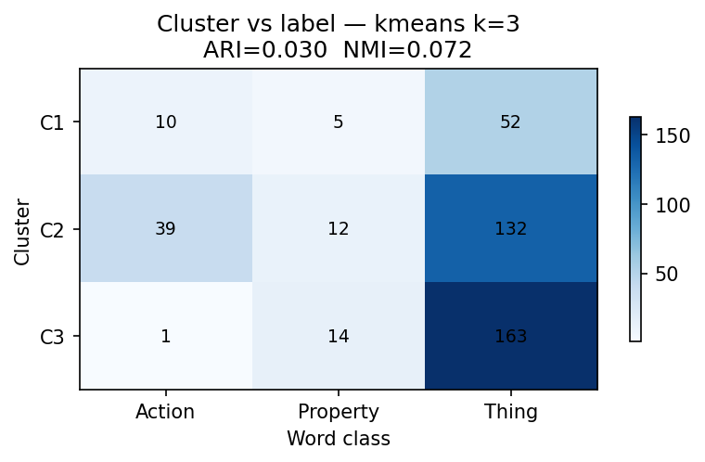
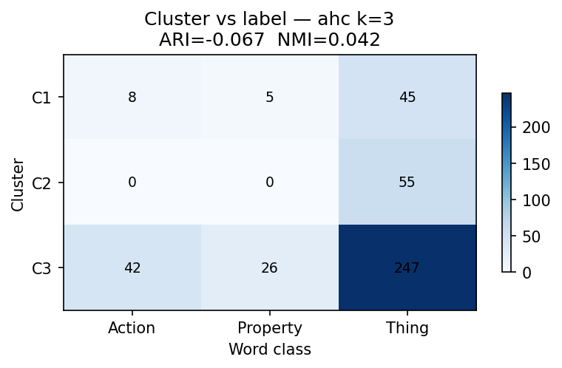
PHASE II — UNSUPERVISED
Clustering: K-Means and AHC
Key finding: clusters do NOT align with grammatical classes · K-Means K=3: ARI=0.030, NMI=0.072 · AHC K=3: ARI=−0.067, NMI=0.042
K-Means K=3 vs original labels
AHC K=3 vs original labels
5 / 15
Best silhouette at K=14 (K-Means: 0.310; AHC: 0.238) — feature space mirrors semantic domains, not grammar.

Slide 6
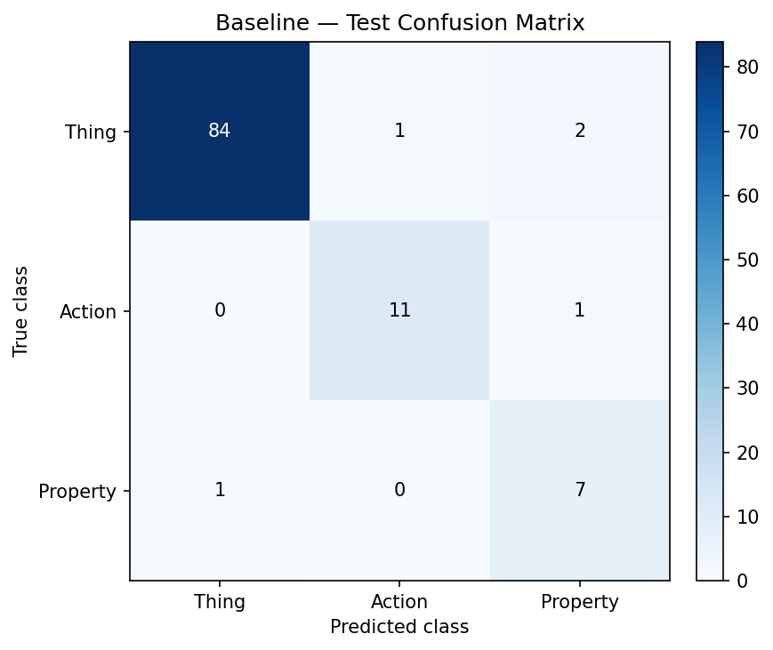
PHASE III — SUPERVISED
Supervised Baseline
Unpenalised multinomial logistic regression on all 65 standardised features
95.3%
91.9%
0.890
81.3%
Test Accuracy
Balanced Accuracy
Test Macro F1
Dummy Majority
Train: 100% (perfect sep.)
All 3 classes recovered
CV mean: 0.859 ± 0.045
Macro F1 = 0.299 only
Test Confusion Matrix
Per-class breakdown
Thing (noun)
Excellent
84/87 correct — dominant class
Action (verb)
Good
11/12 correct — motion/social features key
Property (adj.)
Good
7/8 correct — fewest obs. (7%)
6 / 15

Slide 7
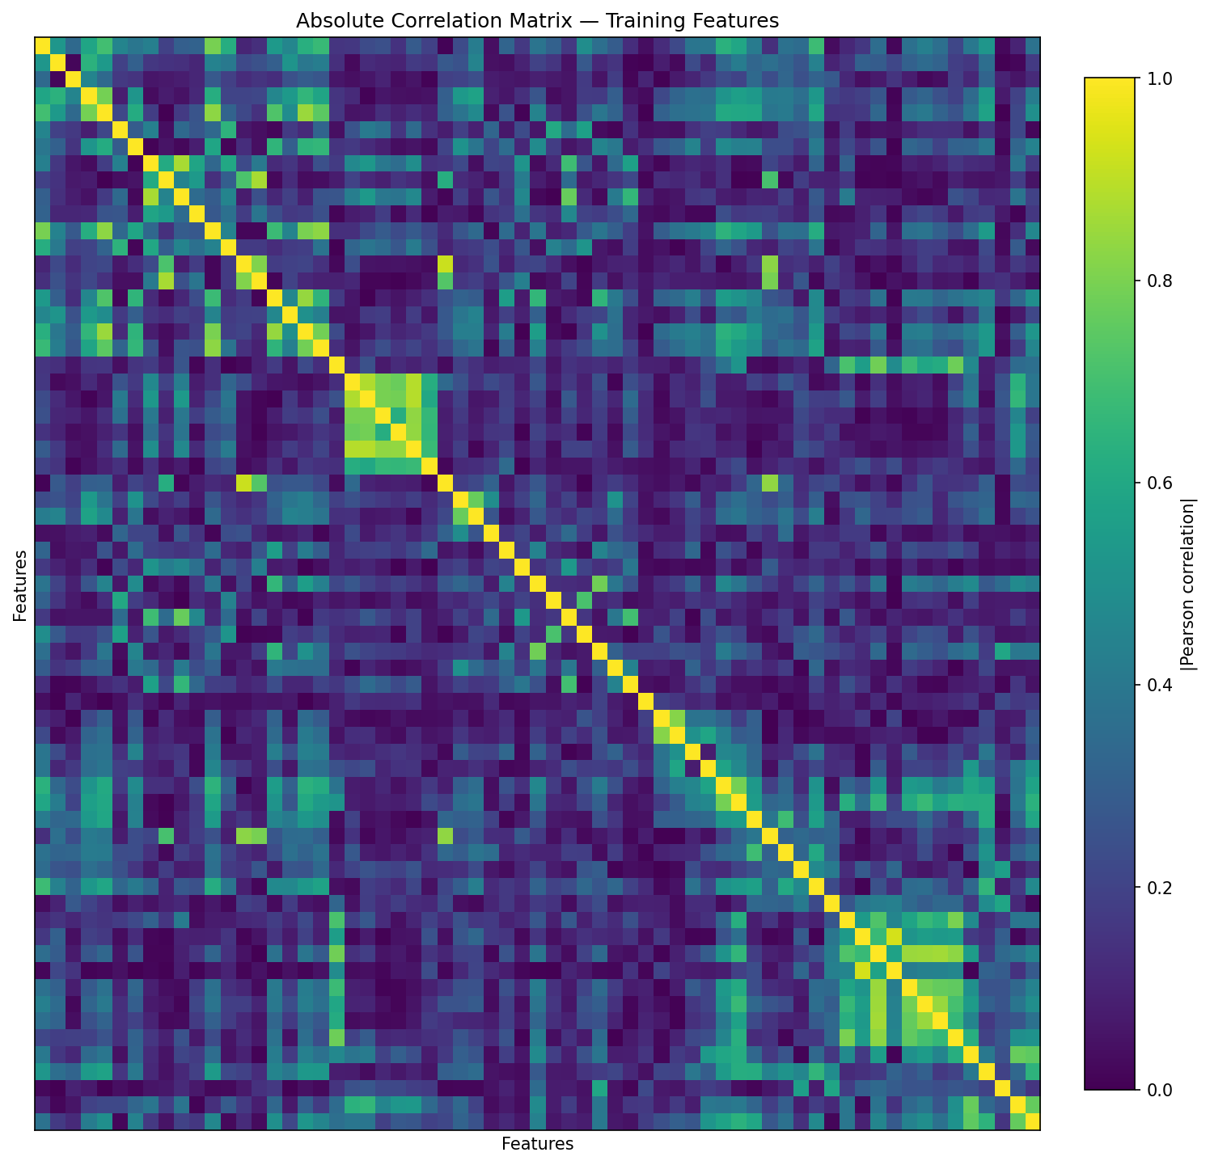
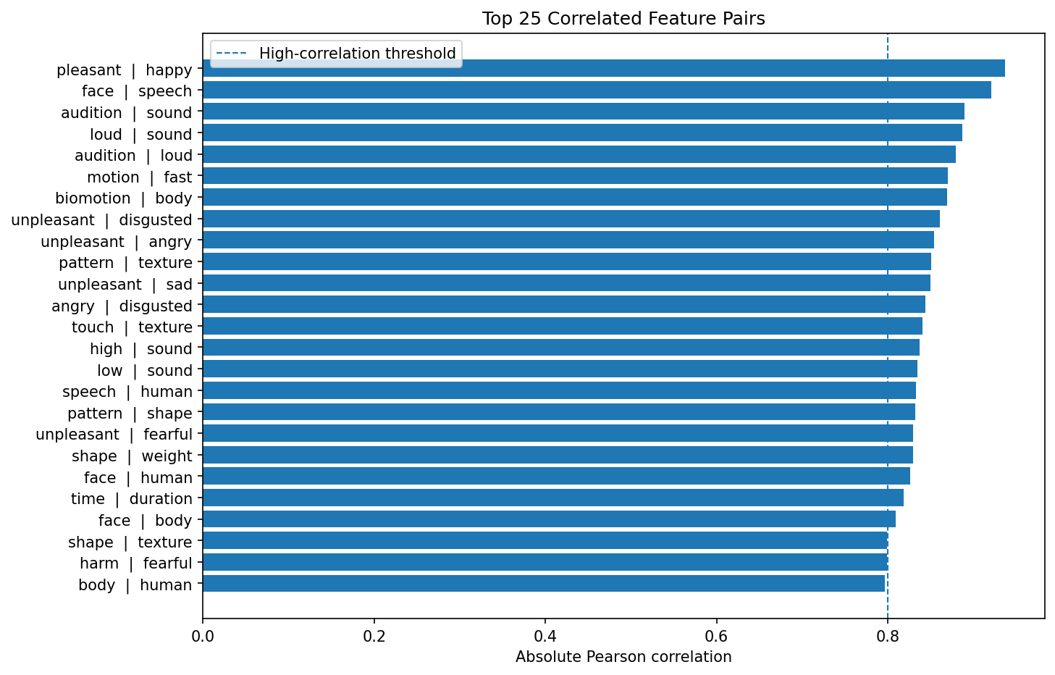
PHASE III — SUPERVISED
Multicollinearity in the Semantic Space
199
22
0.937
51
Pairs |r| ≥ 0.50
Pairs |r| ≥ 0.80
Max |r|
(pleasant–happy)
Features VIF ≥ 5
(max VIF: 23)
Absolute Correlation Heatmap
Top Correlated Feature Pairs
7 / 15
Redundancy is structural, not accidental — it reflects the co-activation of semantic domains in word meanings. Motivates LASSO and Elastic Net.

Slide 8
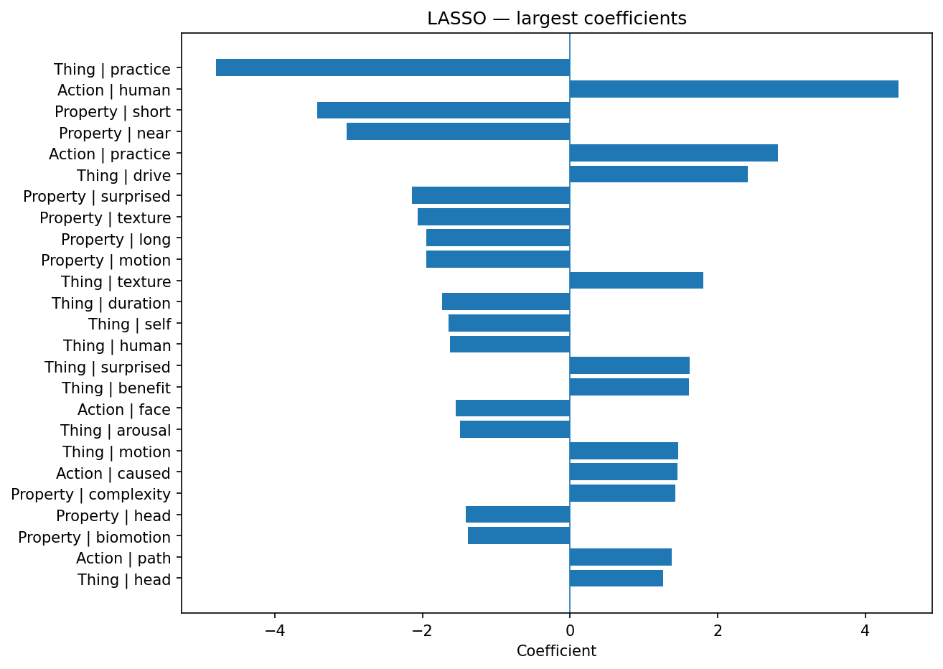
PHASE III — SUPERVISED
Regularised Models: LASSO & Elastic Net
LASSO (L1)
Elastic Net (L1+L2)
Top LASSO coefficients
Best C = 100 (weak regularisation needed)
Best C = 100, L1 ratio = 0.3
172 / 195 non-zero coefs (zero share 11.8%)
192 / 195 non-zero coefs (zero share 1.5%)
All 65 features active — no full sparsity at p=65
L2 dominates — nearly all features retained
Test Macro F1 = 0.890 · Balanced Acc. = 0.919
Test Macro F1 = 0.890 · same as LASSO
Note: paper body Table 7 reports higher values (LASSO 0.968/0.915, EN 0.971/0.920) — paper appendix Table 24 and actual code output both confirm 0.953/0.890.
8 / 15

Slide 9
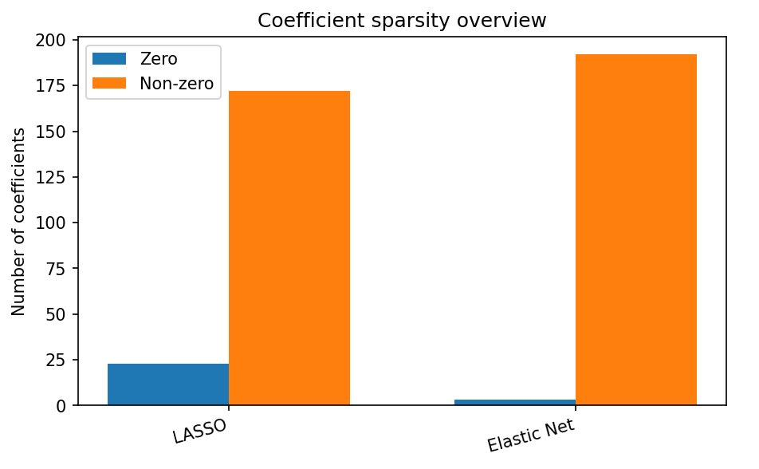
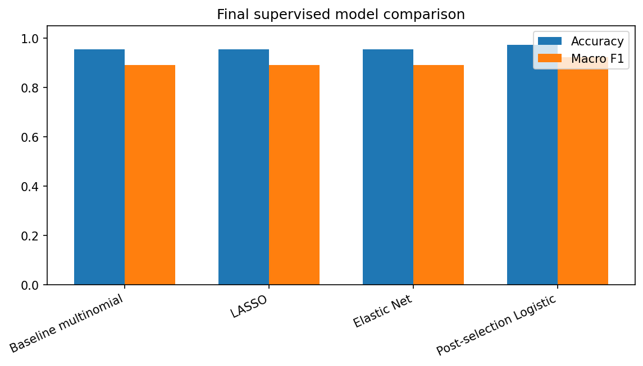
PHASE III — SUPERVISED
Post-Selection Model & Final Comparison
Sparsity overview
Model comparison (test set)
Model
Acc.
Bal.Acc.
Macro F1
Baseline multinomial
0.953
0.919
0.890
LASSO
0.953
0.919
0.890
Elastic Net
0.953
0.919
0.890
Post-selection Logistic
0.972
0.927
9 / 15
0.923

Slide 10
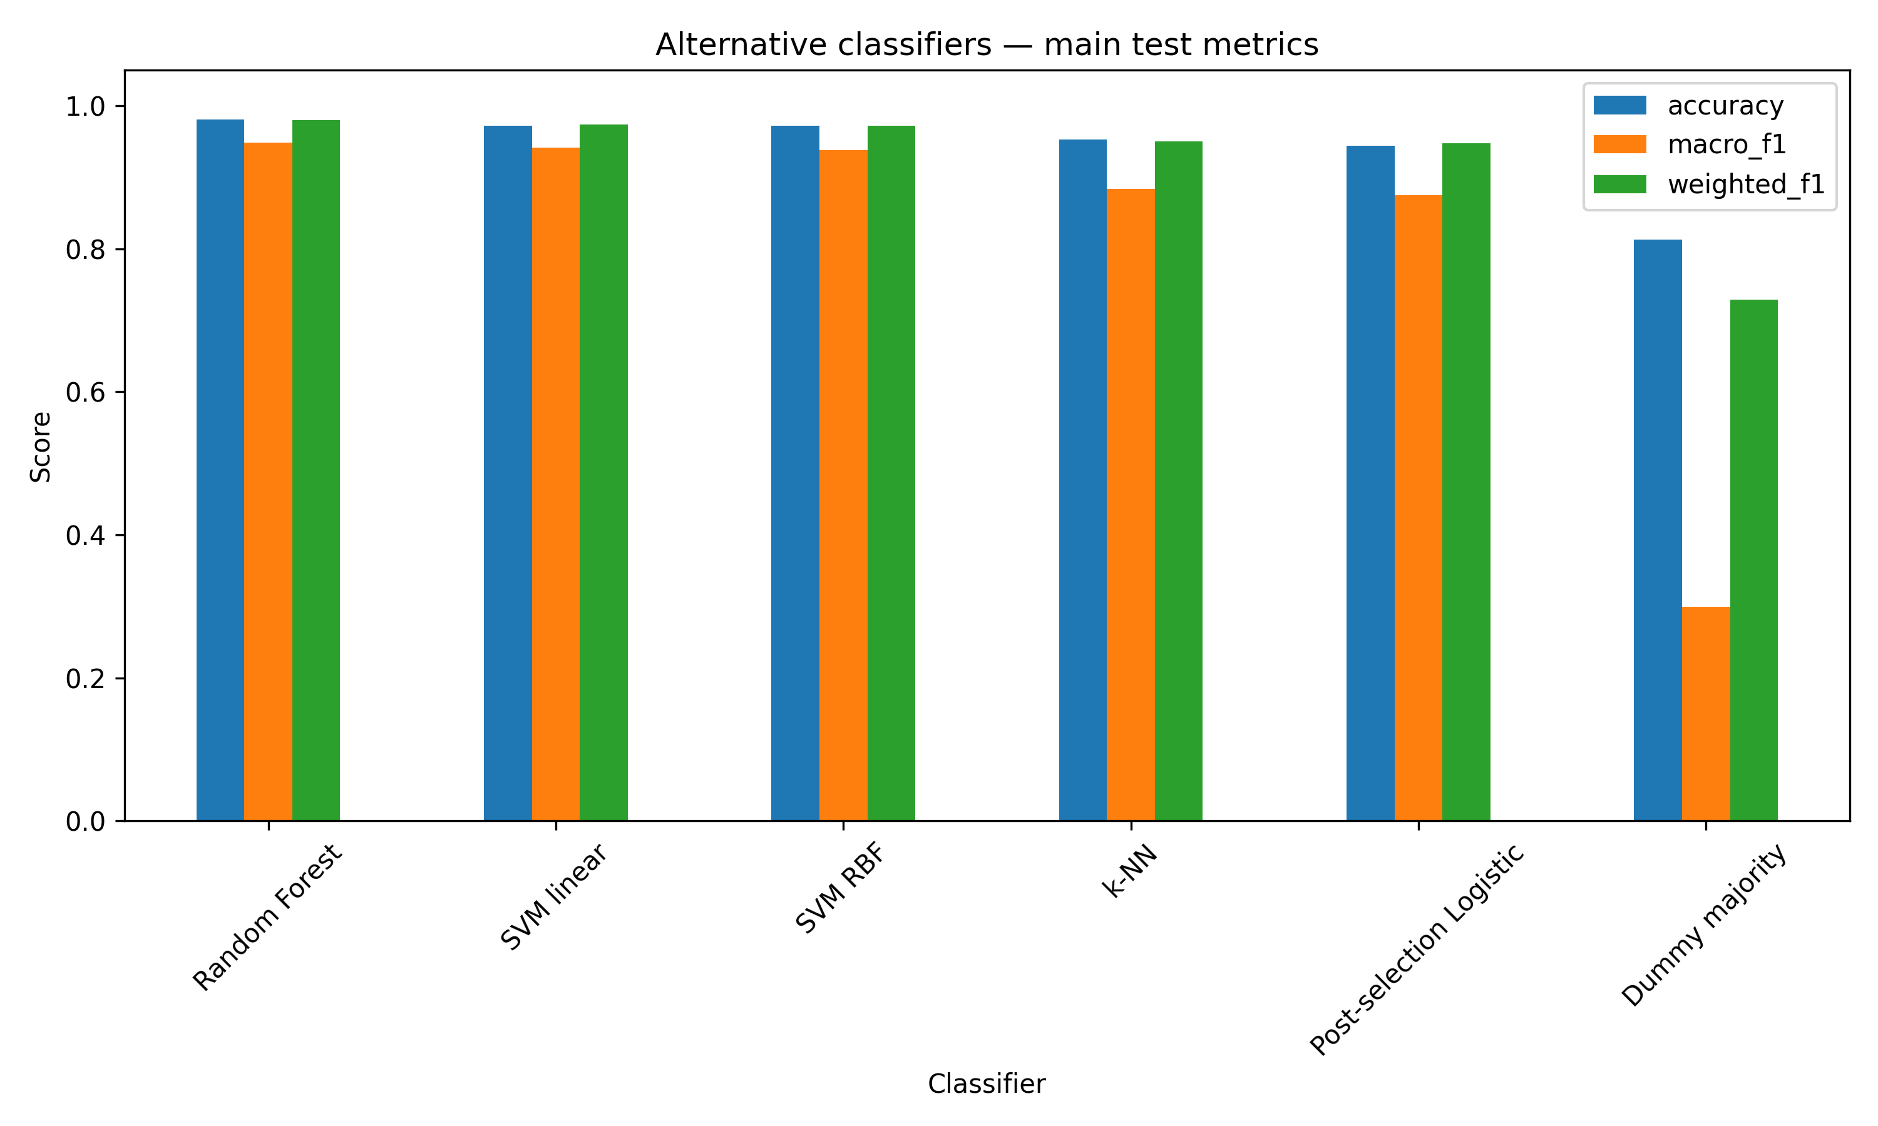
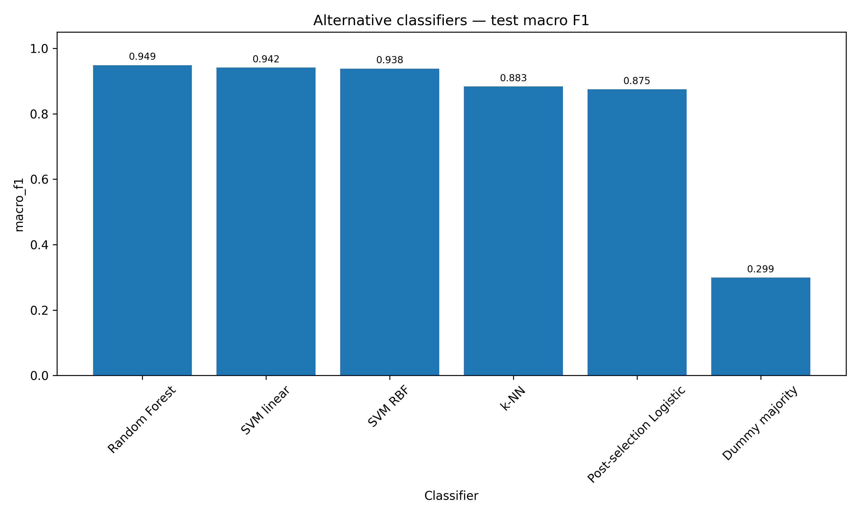
EXTRA PHASE
Alternative Classifiers Comparison
Same 65 selected features — does the classifier family matter?
Main test metrics
Macro F1 ranking
10 / 15
RF: F1=0.949 (best accuracy) · SVM linear: bal.acc.=0.989 (best minority recall) · SVM RBF: C=1,γ=0.01 · k-NN: k=3, euclidean, uniform

Slide 11
PHASE III+ — HIGH DIMENSIONAL
High-Dimensional Expansion: 2210 Features
▸ 65 original + 65 squared + 2080 pairwise interactions = 2210 features
65 vs 2210 features
▸ p/n = 2210/428 ≈ 5.16 → genuine p >> n regime
65
2210
▸ X'X is singular: rank deficiency ≥ 1782 — classical VIF undefined
p > n
No (p<<n)
Yes (p>>n)
VIF
Computable
max=23
Undefined
(X'X singular)
▸ 127,467 pairs with |r| ≥ 0.50; 1,945 pairs with |r| ≥ 0.90
Screening
Not needed
SIS → top 300
SIS
Regularise
Select
Ridge baseline
Acc. 0.953
F1 0.890
Acc. 0.972
F1 0.929
Screen
2210→300
LASSO +
Elastic Net
Post-sel.
refit
LASSO/EN selected
65 (all)
234 / 253
Best test F1
0.923
1.000*
* Perfect test F1=1.000 on HD — small test set (12 verbs, 8 adjectives), interpret cautiously
11 / 15

Slide 12
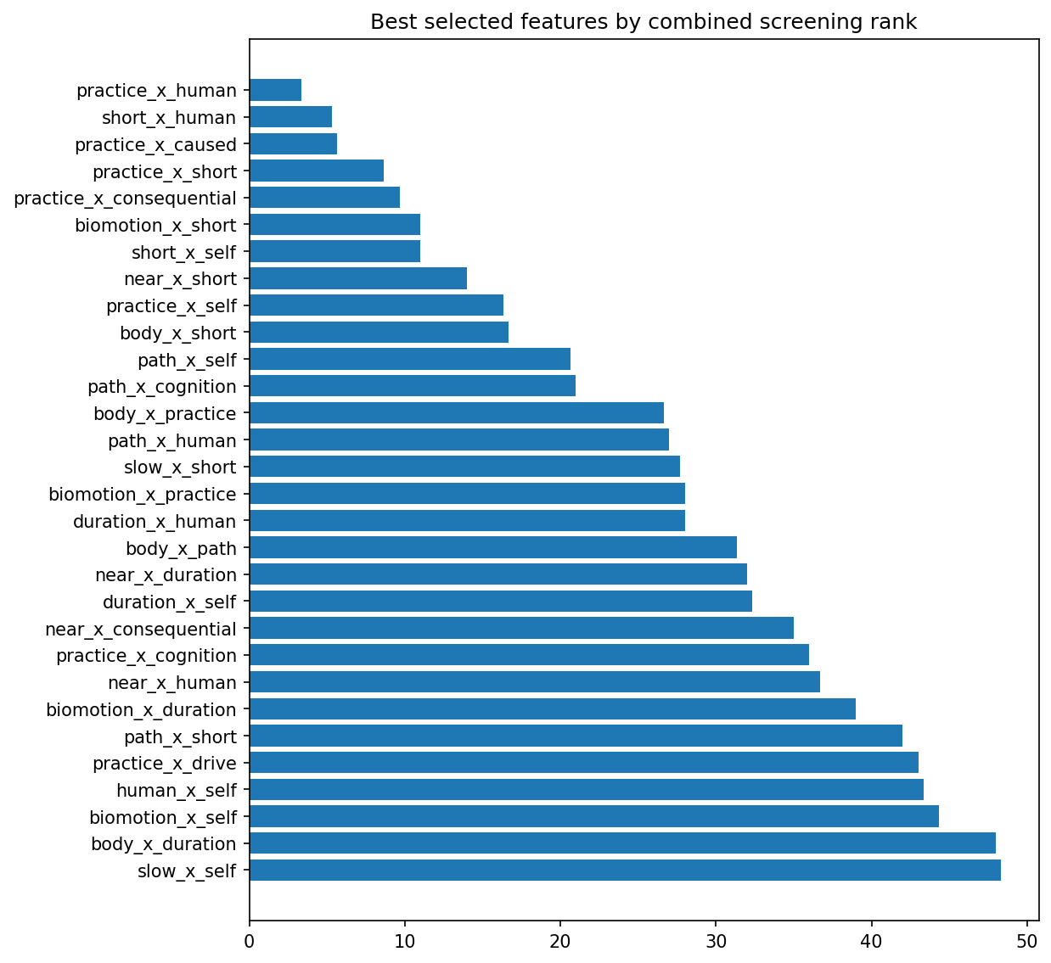
PHASE III+ — SCREENING
Feature Screening on 2210 Features
Combined screening (ANOVA F-score + Mutual Information + class-mean contrast) → top 300 retained
Top 10 screened features
#1
practice_x_human
#2
short_x_human
#3
practice_x_caused
#4
practice_x_short
#5
practice_x_consequential
#6
biomotion_x_short
#7
short_x_self
#8
near_x_short
#9
practice_x_self
#10
body_x_short
12 / 15
Interaction terms dominate: class discrimination is encoded in combined semantic profiles, not isolated dimensions.

Slide 13
PHASE IV — CLUSTER LABELS
Supervised Analysis with K-Means Labels
What if we use the K-Means K=3 clusters as target labels instead of the original word classes?
Cluster
Train
Test
Interpretation
Cluster_01
67 (15.7%)
21 (19.6%)
Cluster_02
183 (42.8%)
34 (31.8%)
▸ Clusters are more balanced than original labels — easier to classify
Cluster_03
178 (41.6%)
52 (48.6%)
▸ High F1 (0.979) confirms the semantic feature space encodes cluster structure well
Cluster-label model performance (test set)
Model
Acc.
Bal.Acc.
F1
▸ Original labels (Thing/Action/Property): best F1 = 0.923
Baseline
0.981
0.974
0.979
LASSO
0.972
0.958
0.967
▸ Cluster labels: F1 = 0.979 — semantic space fits its own clusters better than linguistic categories
Elastic Net
0.981
0.974
0.979
Post-sel. (53 feat.)
0.981
0.974
0.979
▸ Confirms: grammar ≠ semantic similarity, but both are grounded in the Binder features
13 / 15

Slide 14
RESULTS
Key Findings
1
Semantic features are highly predictive
3
Random Forest leads; linear models competitive
Post-selection logistic: 97.2% accuracy, Macro F1 0.923. Far above the 81.3% dummy majority (F1=0.299).
RF: F1=0.949. SVM linear: best balanced acc. (0.989). Post-sel. logistic: F1=0.923, fully interpretable.
2
Clusters ≠ grammatical classes
4
Interaction terms are the strongest HD predictors
K-Means K=3 ARI=0.03, AHC ARI=−0.07. Semantic space captures fine-grained domains, not grammar.
practice_x_human, short_x_human, biomotion_x_short dominate screening. Class info lies in semantic combinations.
14 / 15

Slide 15
Conclusions
Primitive semantic features reliably predict grammatical word class: accuracy 95.3% (baseline) → 97.2% (post-selection), Macro F1 0.890 → 0.923.
Clustering does NOT recover grammatical structure (ARI≈0.03 / −0.07) — the semantic space encodes conceptual similarity, not morphosyntax.
Regularisation does not induce sparsity at p=65: LASSO/Elastic Net keep all features active. Post-selection L2 refit provides the best final linear model.
Random Forest (F1=0.949) is the best single classifier; SVM linear achieves the best balanced accuracy (0.989). Linear models remain strongly competitive.
HD expansion (2210 features, p>>n) with screening + regularisation exposes interaction-based semantic structure. Strongest predictors are semantic combinations (practice_x_human, biomotion_x_short…).
Thank you
Deodati & Pratelli · SLLD Module 2 · Sant'Anna School of Advanced Studies · A.Y. 2025–2026
15 / 15

